Slide 1
RCA
STS Hose reel sub assembly

Slide 2
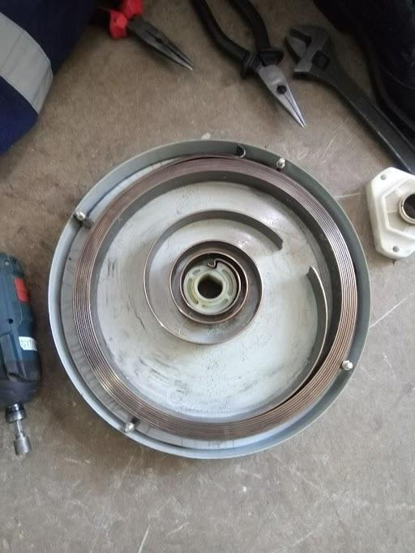
Problem statement
Broken hose recoil spring

Slide 3
5-Why Analysis - Broken hose recoil spring
Why 1 | Why 2 | Why 3 | Why 4 | Why 5 | Root Cause
Wear and tear | Overstretched hose beyond its limit | Long distance from MT to refill box | Busy estate roads | Operator feeling pressure to deliver | Short refill hose lengths

Slide 4
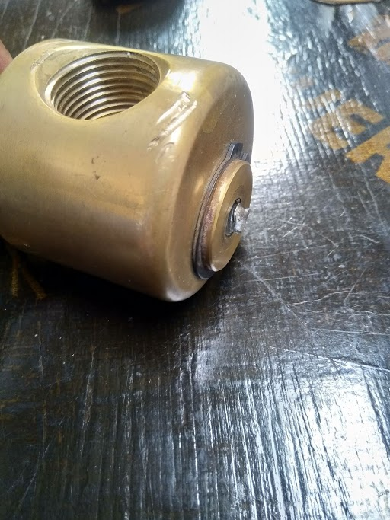
Problem statement
Broken screw connecting the hose reel swivel and hose reel drum

Slide 5
5-Why Analysis - Broken swivel screw
Why 1 | Why 2 | Why 3 | Why 4 | Why 5 | Root Cause
Broken swivel screw | Defective screw (maybe had a weak point hence sheared) | Wear and tear | Excess force on the swivel assembly | Untrained technician (Exerting too much force on the swivel screw) | Lack of training

Slide 6
Recommendations
Make good use the extension delivery hoses (Fuels team)
Refresher trainings for operators and service technicians on best practises (Fuels and Network operations team)
Ensure spare parts is of required specifications (Network operations)

Slide 7

Thank you.

